Slide 1
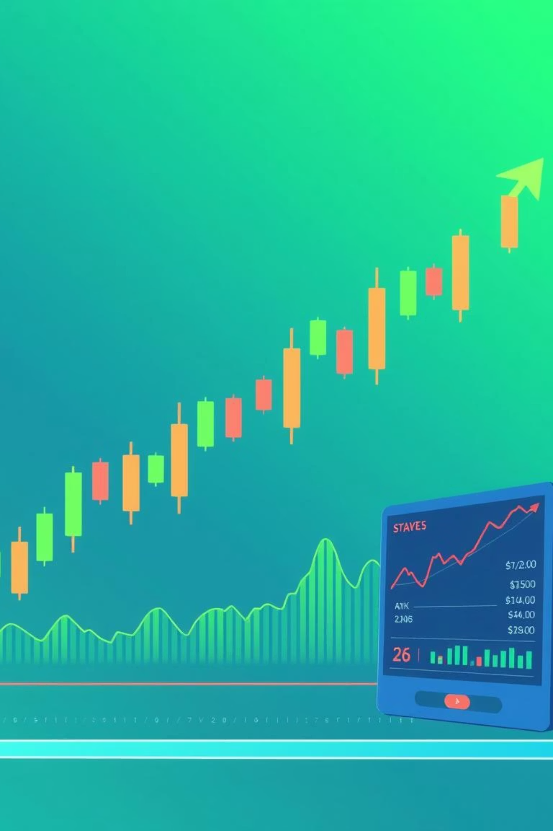
Stock Price Prediction in Pakistan
An analysis of the Pakistan Stock Exchange (PSX) using machine learning algorithms.

Slide 2



Project Overview
Understanding the Dataset
Our analysis utilises an educational dataset from Kaggle, focusing on the Pakistan Stock Exchange (PSX) from December 2021 to December 2024.
Time Period
Data Points
Data Quality
1st December 2021 – December 2024.
Includes Date, Symbol, Open, High, Low, Close prices for 90+ unique stocks.
Clean, organised, and complete with no missing values.

Slide 3
Algorithms Employed
We leveraged two distinct machine learning algorithms for stock price prediction.
LSTM (Long Short-Term Memory)
RandomForest Regressor
Designed for time-series data, remembering past patterns.
Uses multiple decision trees for robust predictions.
Effective with lagged features (e.g., past 30 days' prices).
Learns complex, non-linear behaviours.
Example: Predicts stock bounces after consecutive falls.
Example: Captures patterns from recent price jumps.
Why both? RandomForest provides a strong baseline, while LSTM captures deeper sequential patterns, allowing for valuable comparison.

Slide 4




Alternative Algorithms for Enhanced Accuracy
Beyond our chosen models, several other algorithms could further refine predictions.
XGBoost / LightGBM
1D CNN / TCN
Transformers
Hybrid Models
These options offer diverse approaches, from advanced tree-based models to deep learning networks and classical time-series methods, each suited for different data characteristics.

Slide 5
Solution Error Rates
Our models' performance on the test set revealed key insights into their predictive accuracy.
Model
MAE
MSE
RMSE
R²
RandomForest
27.85
905.93
30.10
-6.64
LSTM
50.29
2647.98
51.46
-21.33
Conclusion: RandomForest outperformed LSTM, but both models require improvement, likely due to the limited features used (only closing prices).

Slide 6




Enhancing Accuracy: Market & Technical Indicators
Incorporating additional features beyond closing prices can significantly boost prediction accuracy.
Trading Volume
Volatility
Indicates market activity; large spikes often precede big price moves.
Measures price fluctuations; spikes can signal impending changes.
Moving Averages
RSI & MACD
Identifies trends and potential crossovers (e.g., Golden/Death Cross).
Detects overbought/oversold conditions and momentum shifts.

Slide 7
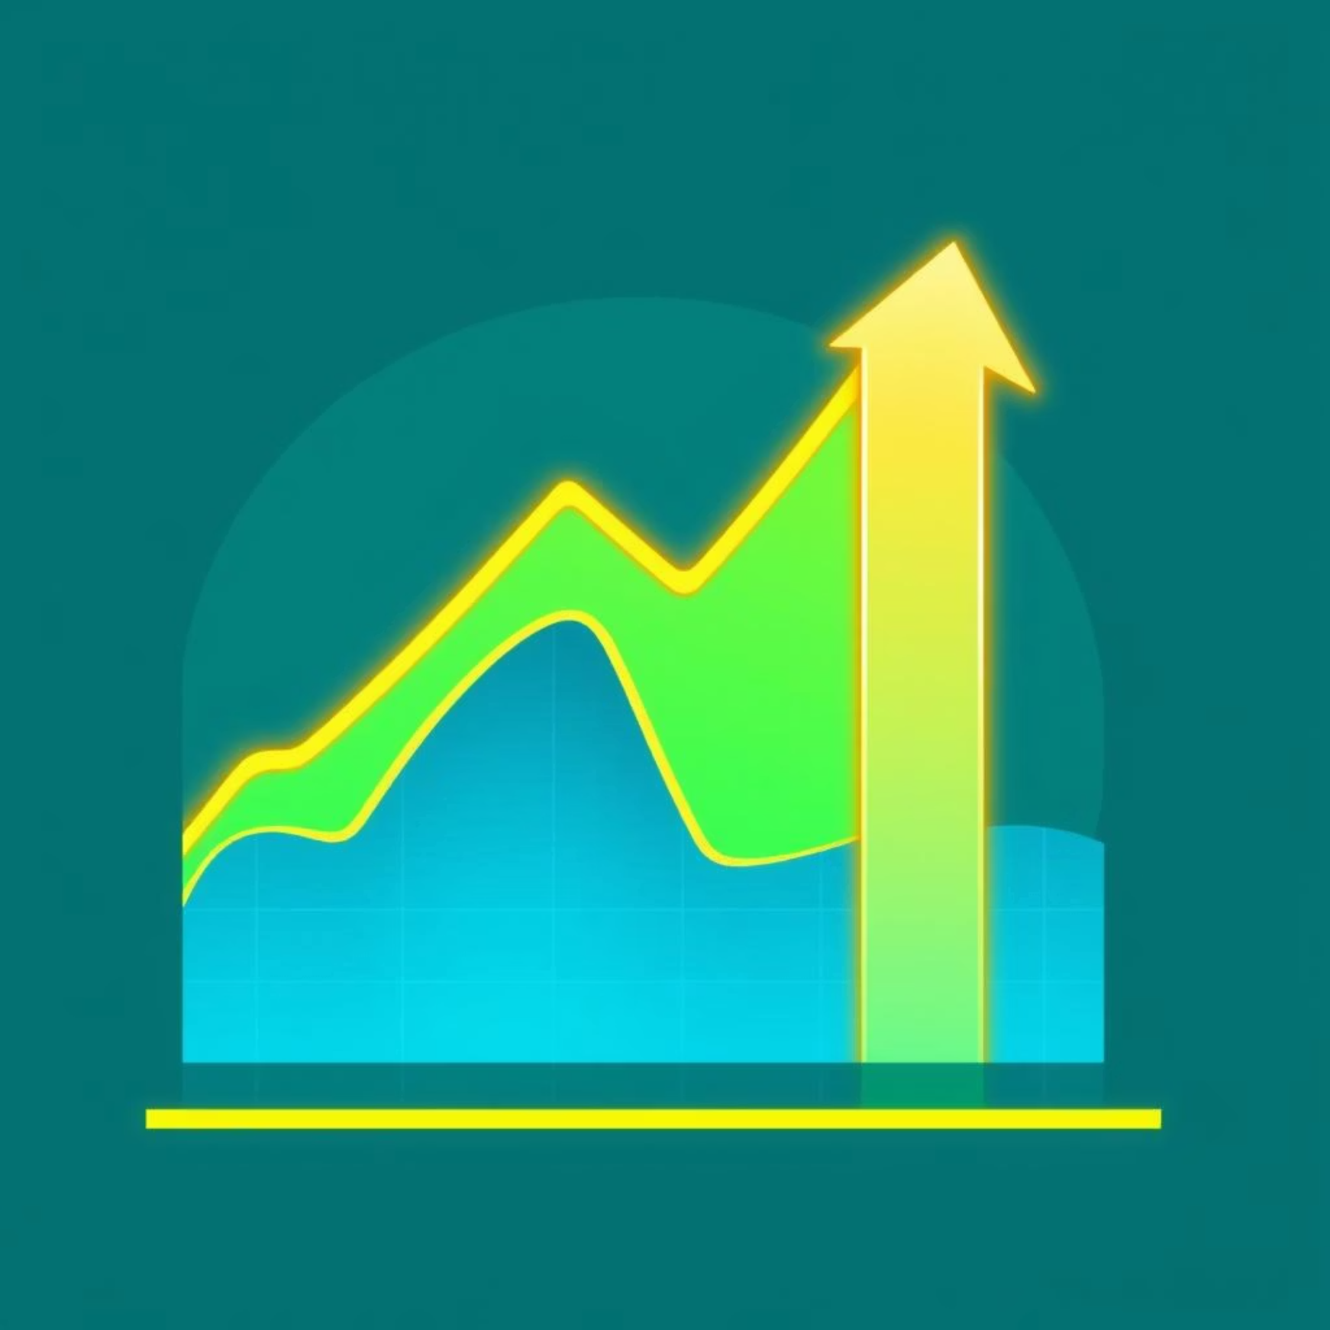
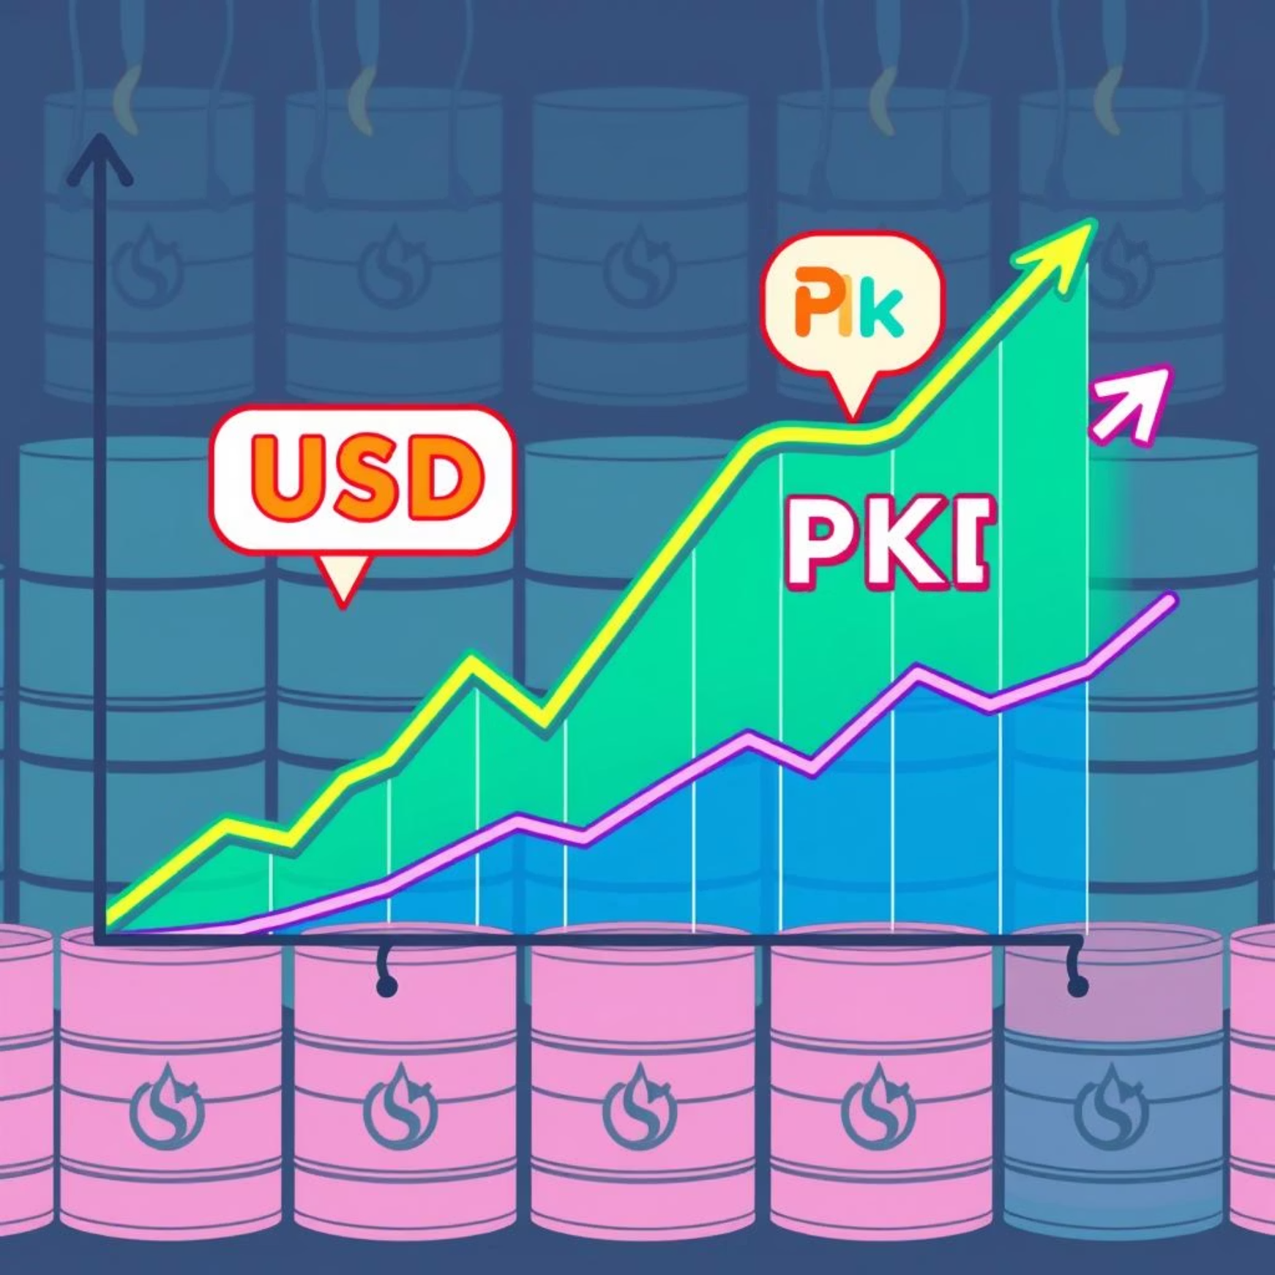
Enhancing Accuracy: External & Macroeconomic Data
External factors and macroeconomic indicators play a crucial role in stock movements.
KSE-100 Index / Sector Index
Currency & Commodity Prices
Stock prices often follow broader market or sector trends.
USD/PKR exchange rates and oil prices are particularly influential in Pakistan.
Interest Rates & Inflation: High interest rates can negatively impact stock prices.

Slide 8
Enhancing Accuracy: Company & News Sentiment
Company-specific events and public sentiment significantly influence stock performance.
Earnings Reports & Dividends
News Sentiment & Social Media
Strong financial results often lead to price surges.
Positive or negative news and social buzz can drive price movements.
Summary: Integrating diverse features—volume, technical indicators, index data, news sentiment, and FX rates—provides a clearer market picture, leading to better price predictions.

